Slide 1
COVID 19 GLOBAL FORECASTING
By Kaggle
Challenge Accepted
2019 - 2020

Slide 2
TABLE OF CONTENTS
01
02
03
04
05
Introduction
Data Understanding
Data Visualization
Data Modeling
Conclusion
2

Slide 3
INTRODUCTION
3

Slide 4
Machine Learning
4

Slide 5

Regression
Decision Tree
Linear Regression
Logistic Regression
XGboost
Supervised Learning
Classification
Naive Bayes
SVM
KNN
Clustering
K-means
Unsupervised Learning
Dimensionality
Reduction
PCA
Feature Selection
Reinforcement Learning
5

Slide 6
Data Science Lifecycle
Business Understanding
Analytic approach
Feedback
Data Requirement
Deployment
Data Collection
Evaluation
Data Understanding
Modeling
Data Preparation
6

Slide 7
01
DATA VISUALISATION
&
DATA UNDERSTANDING
7

Slide 8
DATA UNDERSTANDING
Train.csv
01
Test.csv
02
03
Submission.csv
The training Data
The dataset to predict
8
Notes:
Data Source
This evaluation data for this competition comes from John Hopkins CSSE, which is uninvolved in the competition.
They are currently updating the data daily.

Slide 9
DATA UNDERSTANDING
Province_State | Country_Region | Date | ConfirmedCases | FatalitiesCases
Italy | Italy | 13/05/2020 | 222104 | 31106
Tunisia | Tunisia | 13/05/2020 | 1032 | 45
9

Slide 10
4,837,361
Data Visualization
Cases detected
6.4%
93.6%
Fatalities Cases
Confirmed Cases
10

Slide 11
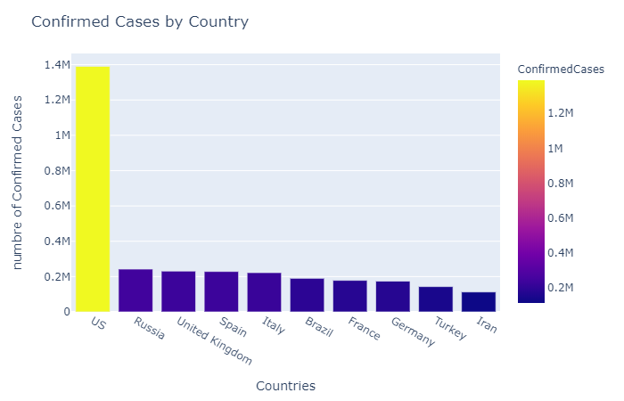
Data Visualization
Top 10 Confirmed Cases By country
11

Slide 12
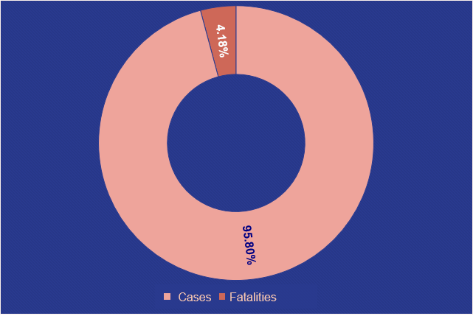
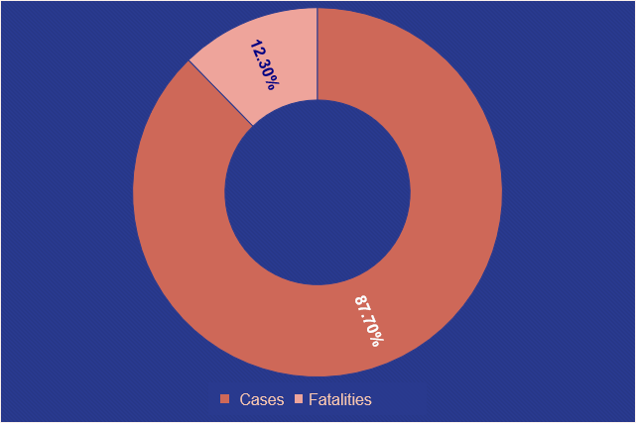
Data Visualization
Tunisia
Italy
12

Slide 13
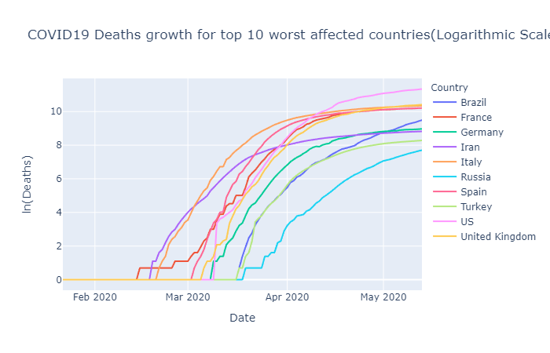
Data Visualization
Deaths growth for top 10 worst affected countries
13

Slide 14
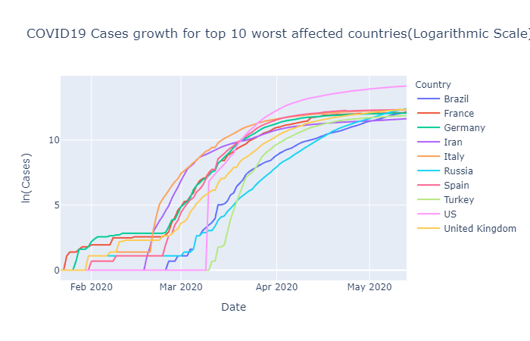
Data Visualization
Cases growth for top 10 worst affected countries
14

Slide 15
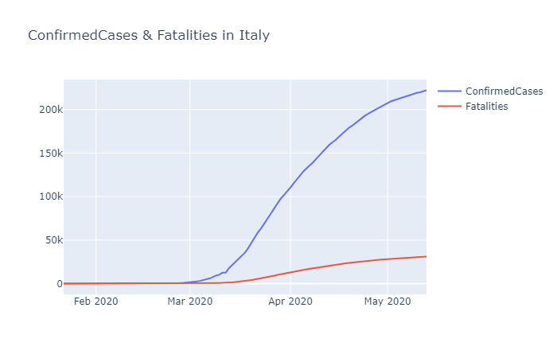
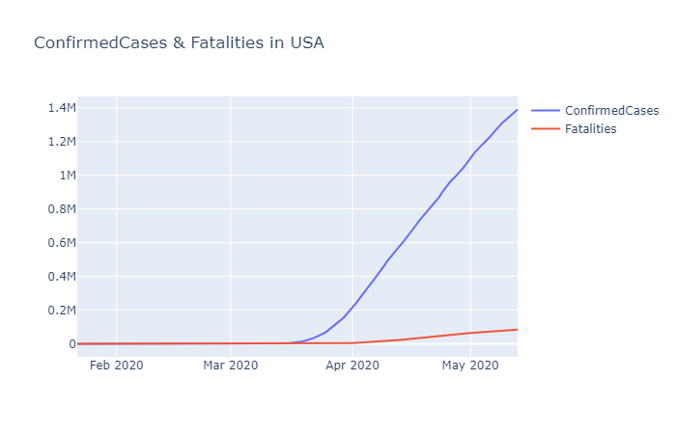
Confirmed and Fatalities cases in Italy
Confirmed and Fatalities cases in USA
15

Slide 16
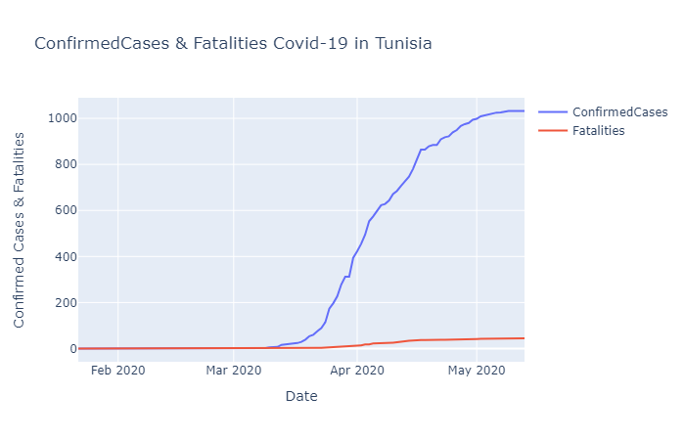
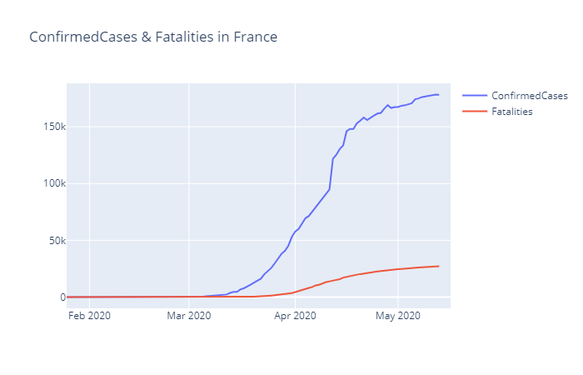
Confirmed and Fatalities cases in Tunisia
Confirmed and Fatalities cases in France
16

Slide 17
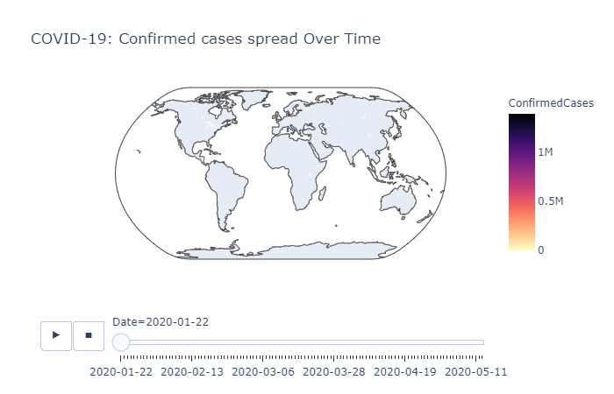
Data Visualization
Confirmed Cases spread over time
17

Slide 18
02
DATA PREPARATION
18

Slide 19
Feature generation (1/2)
Create features from “Date” Feature
Date
2020-01-22
2020-01-23
2020-01-24
………
2020-05-12
2020-05-13
2020-05-14
dayofweek | quarter | month | dayofyear | dayofmonth | weekofyear
2 | 1 | 1 | 22 | 22 | 4
3 | 1 | 1 | 23 | 23 | 4
4 | 1 | 1 | 24 | 24 | 4
……………
1 | 2 | 5 | 133 | 12 | 20
2 | 2 | 5 | 134 | 13 | 20
3 | 2 | 5 | 135 | 14 | 20
19

Slide 20
Feature generation (2/2)
Merge the Country feature with the state Feature
Province_state | Country_Region
New Brunswick | Canada
Nan | Bolivia
Nan | Tunisia
Jilin | China
Idaho | US
Queensland | Australia
Nan | Germany
Nan | France
Country_Sate
Canada_New Brunswick
Bolivia_
Tunisia_
China_Jilin
US_Idaho
Australia_Queensland
Germany_
France_
Country_State
69
39
387
71
417
24
126
105
20

Slide 21
03
DATA
MODELING
21

Slide 22
Data Modeling
01
03
05
Ridge
ARIMA
SVM
XGboost
CART
02
04
22

Slide 23
Ensemble methods
23

Slide 24
XGboost
Extreme Gradient Boosting
Custom tree building algorithm
Used for :
Interface for Python & R
classification
Regression
Ranking
24

Slide 25
XGboost
01
02
03
04
0,9
135.2
780.09
0,9
RMSE
2
SCORE
MAE
R
25

Slide 26
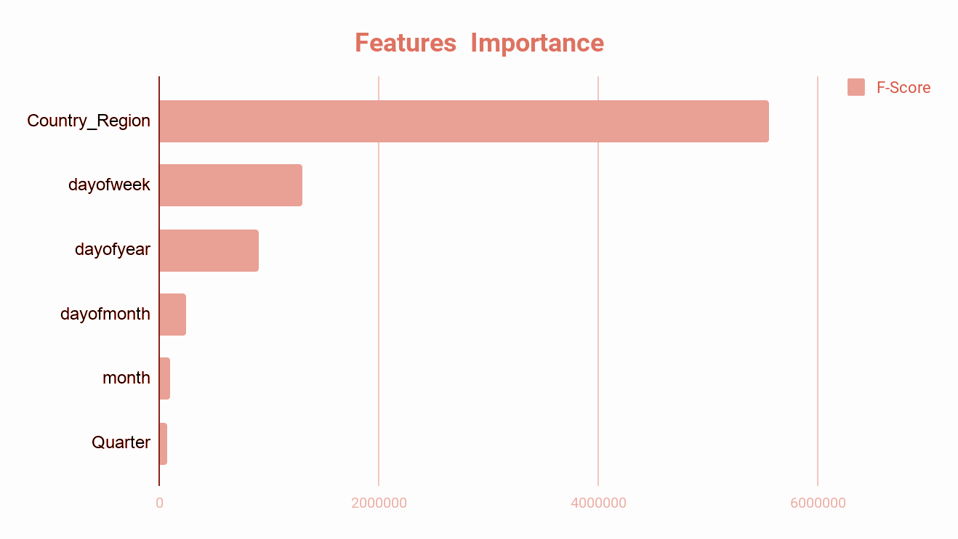
Features Importance
Features
F score
26

Slide 27
The linear Family
27

Slide 28
RIDGE
Add a penalty term to reduce overfitting
Reduce the model complexity
Used for :
Better long term prediction
Classification
Regularisation
28

Slide 29
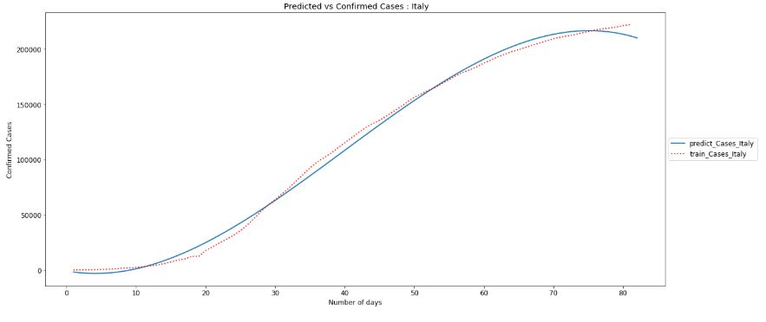
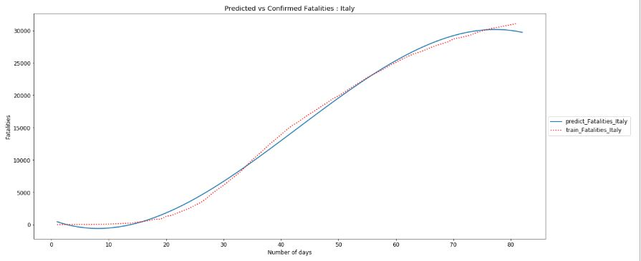
Prediction Cases & Fatalities in ITALY with RIDGE
29
Prediction Cases in Italy
Prediction Fatalities in Italy

Slide 30
Decision Tree Algorithms
30

Slide 31
CART
Predictive model :
helps to find a variable based on other labeled variables
The representation for the model is a binary tree
Able to capture the non-linearity in the dataset
(Classification And Regression Trees)
The leaf node will tell the final prediction
31

Slide 32
Support Vector Machine
32

Slide 33
SVM ( Support Vector Machine)
Effective in high dimensional spaces
Used for :
Interface for Python & R
Finding an hyper-plane that differentiates between the classes very well
Classification(SVC)
Regression (SVR)
33

Slide 34
SVR
34

Slide 35
Time Series
35

Slide 36
ARIMA
ARIMA(p,d,q)
p : The Lag Order
q:The order of moving average
d: The degree of differencing
AR: AutoRegression
I: Integrated
MA: Moving Average
Used for :
Interface for Python & R
Understand the data
Eliminate the non-stationarity
Predicting future points in the series(Forecasting)
36

Slide 37
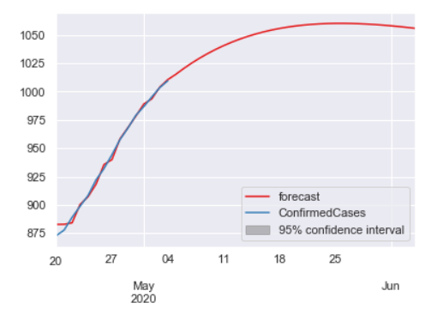
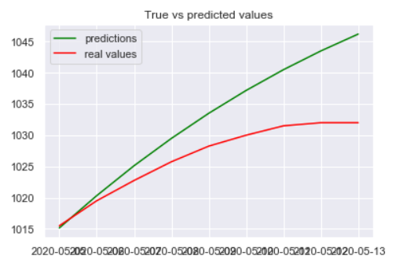
CONFIRMED CASES TUNISIA
37

Slide 38
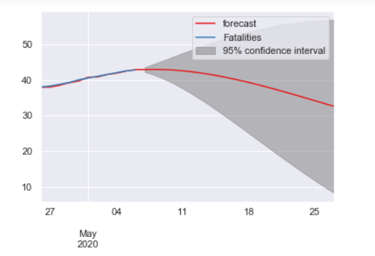
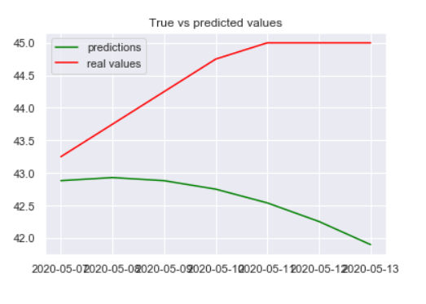
FATALITIES TUNISIA
38

Slide 39
Supervised Learning with Neural Networks
39

Slide 40
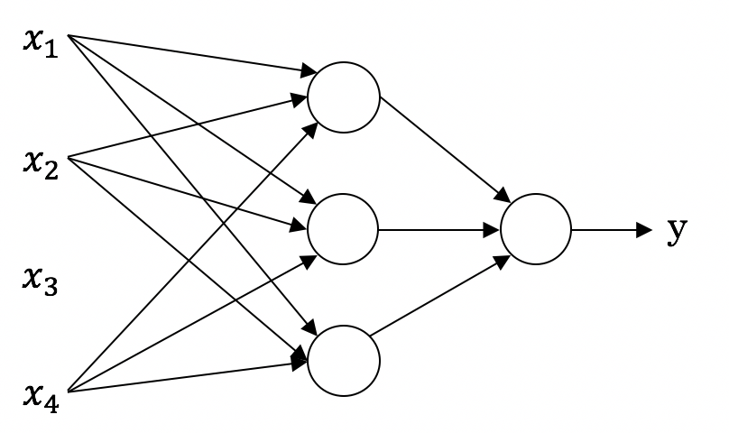
Neural Network examples
Standard NN
40

Slide 41
Deep Learning
3077
Confirmed Cases
Fatalities
MAE
MAE
110.15
41

Slide 42
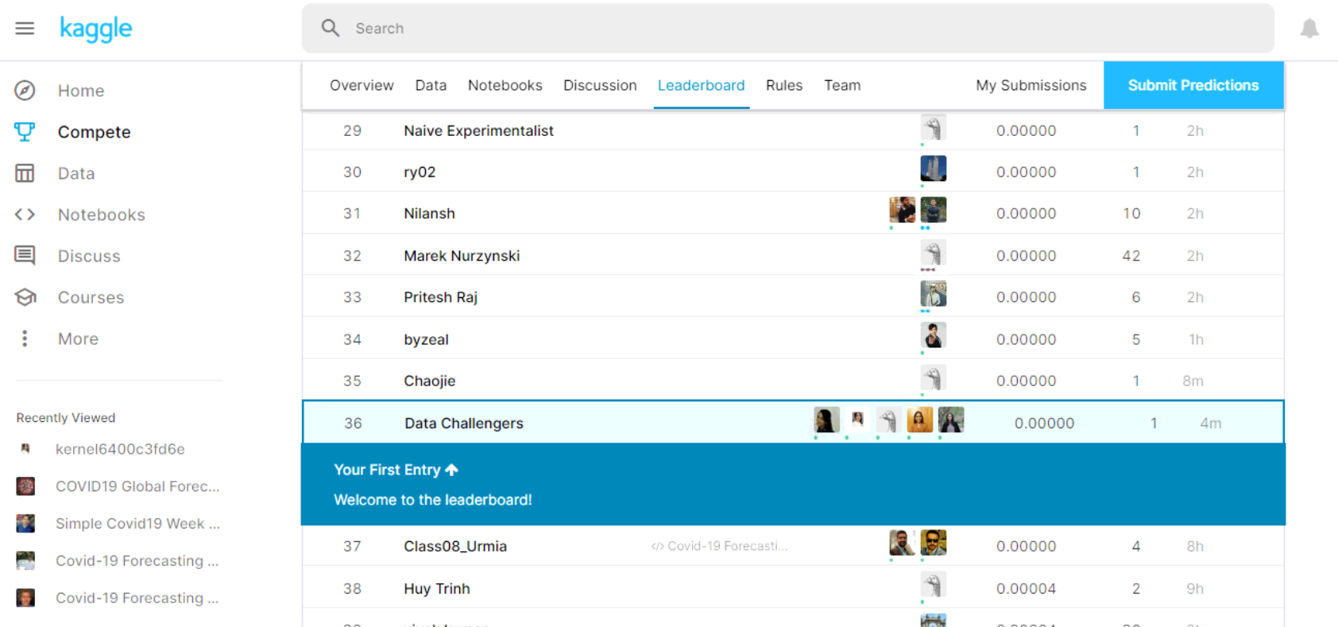
Kaggle Competition
42

Slide 43
Stay Safe
Stay at Home
Thank You

